Slide 1
WorkshopPLUS Power Platform for Administrators
Power Platform Analytics & Monitoring
Notes:
Workshop Version: 2.6

Slide 2
Conditions and terms of use
© Microsoft Corporation. All rights reserved.
You may use these training materials solely for your personal internal reference and non-commercial purposes. You may not distribute, transmit, resell or otherwise make these training materials available to any other person or party without express permission from Microsoft Corporation. URL’s or other internet website references in the training materials may change without notice. Unless otherwise noted, any companies, organizations, domain names, e-mail addresses, people, places and events depicted in the training materials are for illustration only and are fictitious. No real association is intended or inferred. THESE TRAINING MATERIALS ARE PROVIDED “AS IS”; MICROSOFT MAKES NO WARRANTIES, EXPRESS OR IMPLIED IN THESE TRAINING MATERIALS

Slide 3

Objectives
After completing this Learning, you will be able to:
 | 1 | Understand…. What Power Platform events are logged in Office 365 Audit Logs
 | 2 | Understand…. How to monitor environments’ storage capacity
 | 3 | Understand…. What out-of-the-box analytics and reporting features of Dataverse, Power Apps and Power Automate analytics are available
 | 4 | Understand…. How to check and monitor Power Platform services health

Slide 4
Activity events in Office 365 Audit Logs

Slide 5
Access Audit Logs
PowerApps, Power Automate, Dataverse audit records are available at https://compliance.microsoft.com/auditlogsearch
ACTIVITY LOGGING
Available with Office E3 or greater license and integrated with Office Security and Compliance center.
Must be enabled at the organization/tenant level
Office provides API’s to query this data, which is currently used by many SIEM vendors to use the Activity Logging data for reporting.

Slide 6
Monitor Activity Parameters for Power Apps & Automate
Power Automate
Power Apps
Created flow
Edited flow
Deleted flow
Edited permissions
Deleted permissions
Started a paid trial
Renewed a paid trial
Created app
Edited/save app (draft)
Published app
Deleted app
Restored an app from app version
Launched app
Marking app as featured
Marking app as hero
Edited app permissions
Deleted app permissions

Slide 7
Monitor Critical Activity Parameters of the Dataverse
Admin Activity Logged
User Activity Logged
Publishing customizations
Configuring instances by adding solutions to instance
Team and user management - who was added, deleted, access rights of user/team
Deletes of attributes
Backup and Restore actions
Managing instances - New instance added and delete instance
Creates, Reads, Updates, Deletes on records and Dataverse metadata
Dataverse record views
Export to excel
SDK calls
Backend Microsoft support engineer CRUD activities
Reports viewed

Slide 8
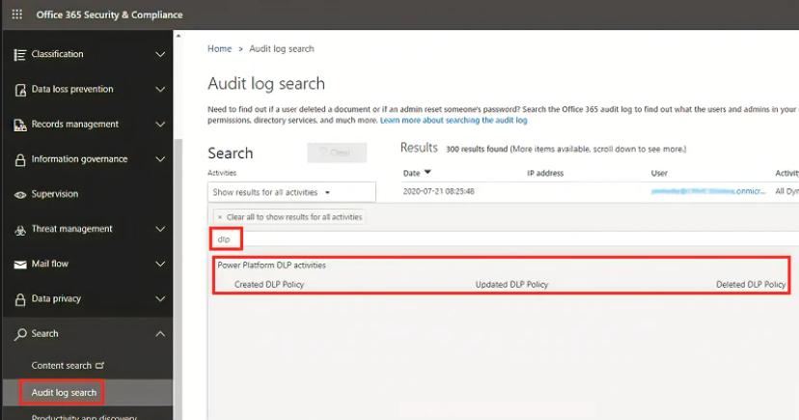
Data loss prevention activity logging
DLP Audited Events
Created DLP Policy
Updated DLP Policy
Deleted DLP Policy

Slide 9
Monitor Connector Activity (preview)
Connector event | Description
API created | When a custom API is created
API edited | When a custom API is updated
API deleted | When a custom API is deleted
Connection created or edited | When a connection is created or updated
Connection deleted | When a connection is deleted
Connection edited | When a connection is updated
API permission added or edited | When a custom API is shared or the permissions are updated
API made solution-aware | When a non-solution API is moved to a solution
API permission removed | When sharing permissions of a custom API are removed
Connection permission added or edited | When a connection is shared or sharing permissions are updated
Connection permission removed | When sharing permissions of a connection are removed
Gateway cluster edited | When a gateway cluster is updated
Gateway permission added or edited | When a gateway is shared or the sharing permissions are updated
Gateway permission removed | When sharing permissions of a gateway are removed
Notes:
View the Power Platform connector activity logs (preview) - Power Platform | Microsoft Learn

Slide 10
Monitoring Storage Capacity and Add-On’s

Slide 11
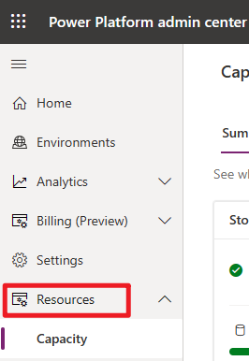
Gain Deeper Insight on Storage Capacity
Capacity management & enforcement
Understand storage and consumption
Access for environment admins, power platform service admins, D365 and global admins and individual users who have purchased a license
https://aka.ms/ppac

Slide 12
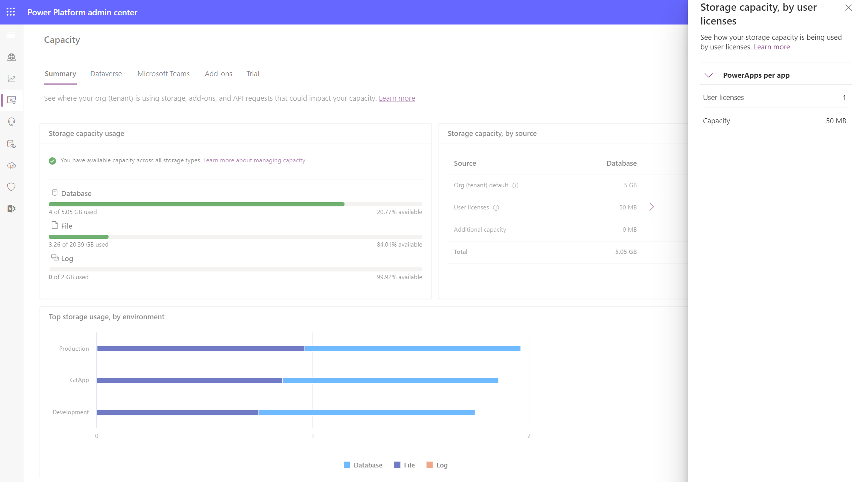
Capacity Page Details
In Power Platform Admin Center, select Resources > Capacity > Summary
All tables of Dataverse, including system tables, are included in the storage capacity reports.
Storage capacity usage
Database – All tables
File – Tables having file or image data type as well as Attachment, AnnotationBase, Insights application OOB tables
Log – AuditBase & PlugInTraceLogBase tables (Audit logging)
Storage capacity, by source (Database, File, Log)
Org (tenant) default
User licenses - Additional capacity added for every user license purchased
Additional storage - Any additional storage you bought like add-on
Total storage available
Top storage usage, by environment
Assigned storage capacity per license
4
2
1
3

Slide 13
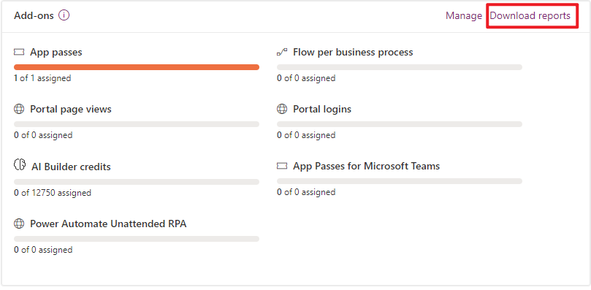
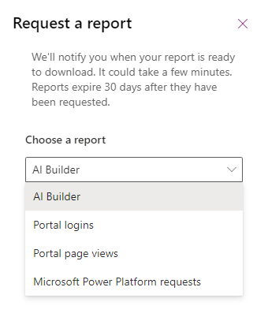
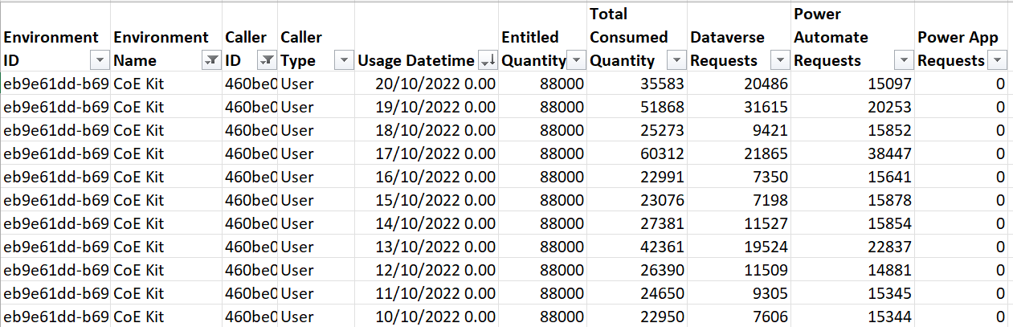
Capacity add-on reports
In Power Platform Admin Center, select Resources > Capacity > scroll down to the Add-ons card and click Download Reports
AI Builder
Portal logins
Portal page views
Microsoft Power Platform requests

Slide 14
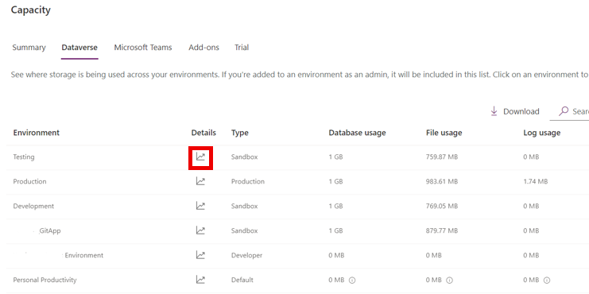
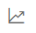
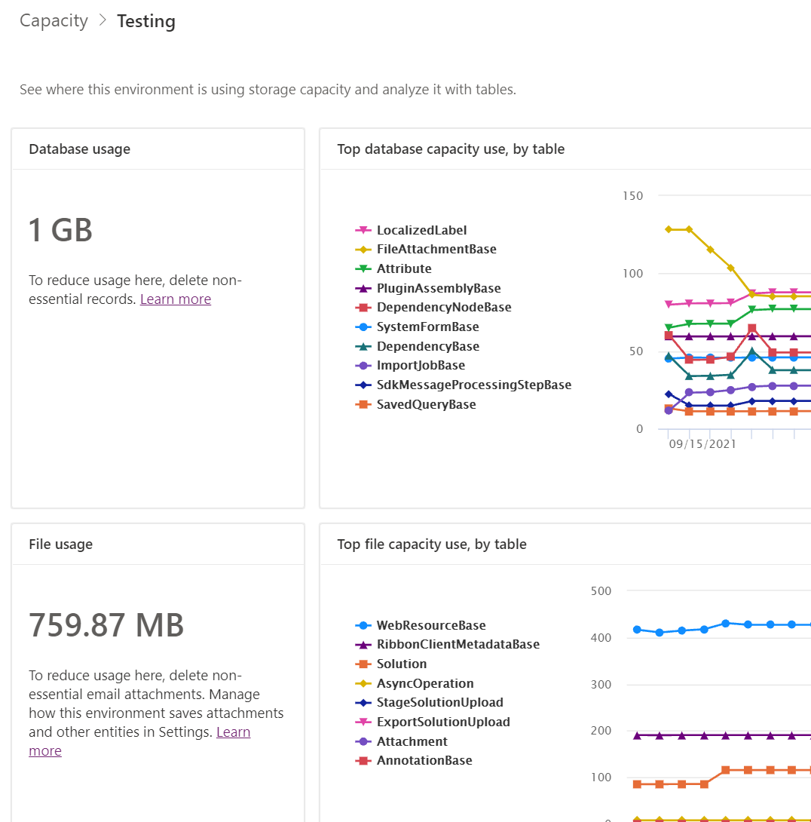
Environment level breakdown
In Power Platform Admin Center, select Resources > Capacity > Dataverse
Provides similar information as the Summary tab, but with an environment-level view
See environment capacity analytics details by clicking ( )
Note that following environments don't count against capacity and are shown as 0 GB:
Trial
Preview
Support
Developer
You can select an environment that's showing 0 GB, and then go to its Environment Analytics page to see the actual consumption.

Slide 15
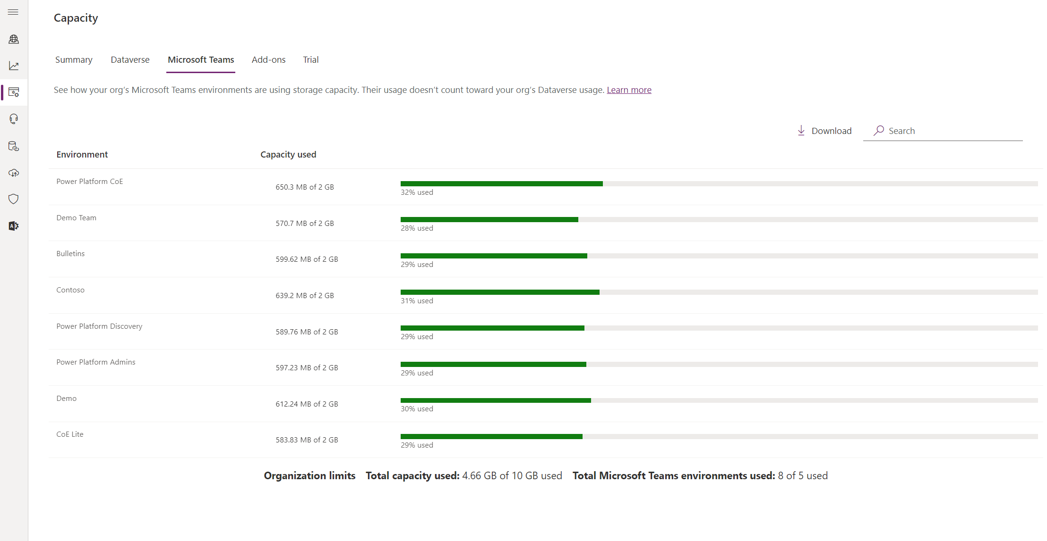
Capacity of Dataverse for Teams environments
In Power Platform Admin Center, select Resources > Capacity > Microsoft Teams
Provides information about database capacity of Microsoft Teams environments
As the Summary tab, but with an environment-level view

Slide 16
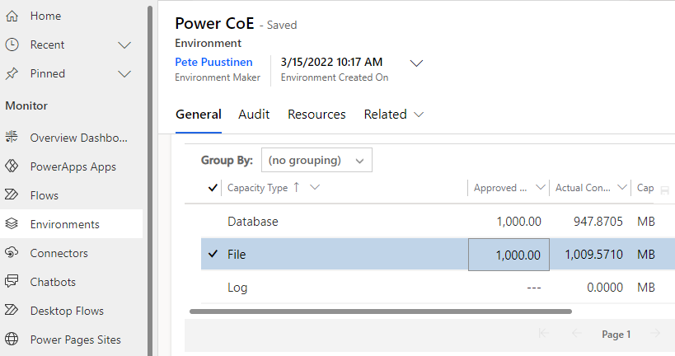
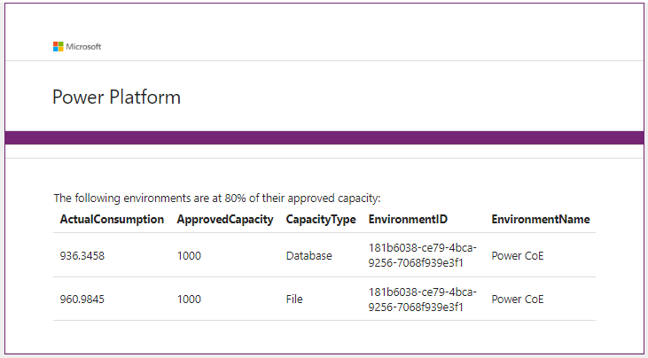
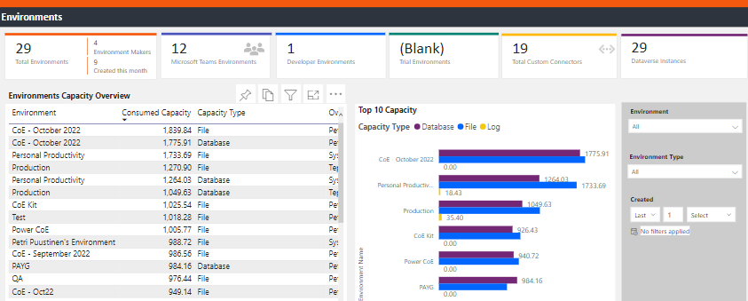
Environment capacity management & alerting (CoE Starter Kit)
Power Platform does not currently support environment level capacity and quota management
CoE Starter Kit, we cover in next module, has functionality which allows admins to define soft capacity limits for Dataverse database, file and log
With this feature it is possible to monitor environments’ database usage and send alert to admins if environments are over or 80% close to approved capacity
Admins can monitor environment capacities using CoE Power BI dashboard
Environment capacity management & alerting - Power Platform | Microsoft Learn
Notes:
Pete I think it’s worth mentioning this process as part of the CoE Kit here even though it’s not installed, but the ability to get alerts for soft limits sets is huge.

Slide 17
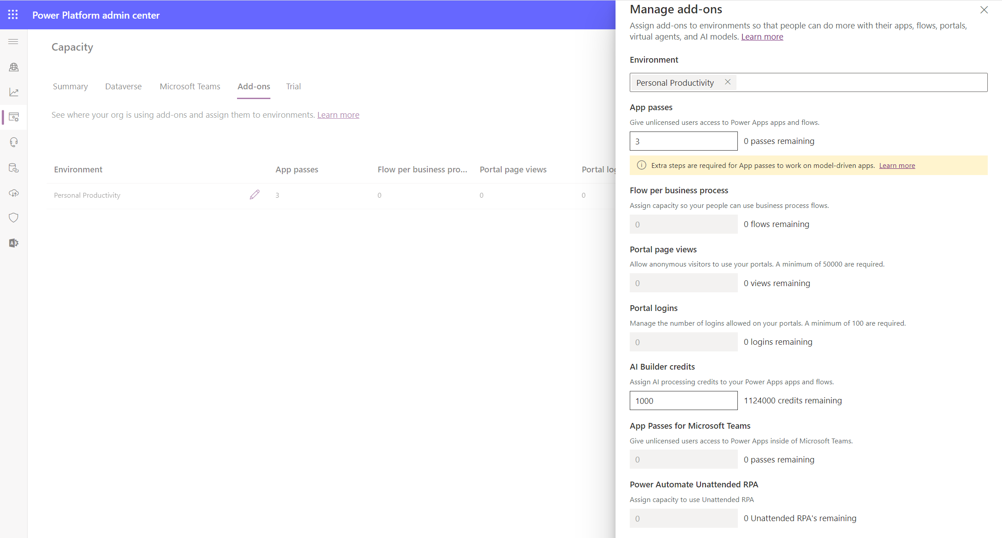
Capacity add-on assignments per environment
In Power Platform Admin Center, select Resources > Capacity > Add-ons
View and assign capacity add-ons per environment

Slide 18
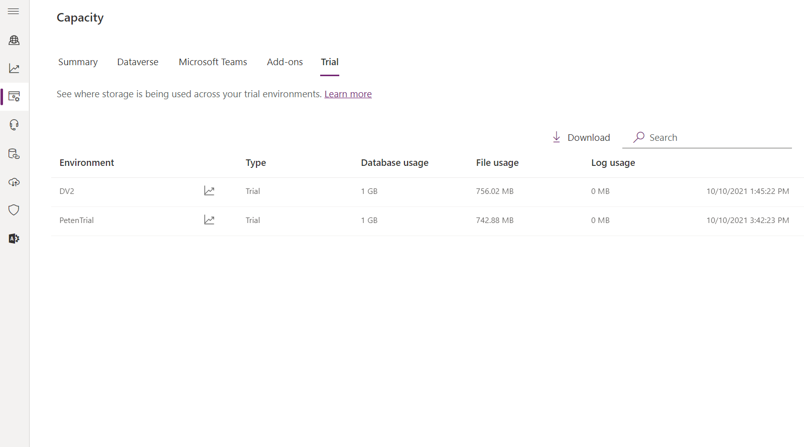
Trial environments
In Power Platform Admin Center, select Resources > Capacity > Trial
Trial environments do not consume tenant level capacity unless converted to production environment

Slide 19

Demonstration
Power Platform capacity reports
Demo the following:
Go through all capacity reports in PPAC
Notes:
Consider demoing the following:
Go through all capacity reports in PPAC
##########

Slide 20
Dataverse, Power Apps and Power Automate Analytics

Slide 21
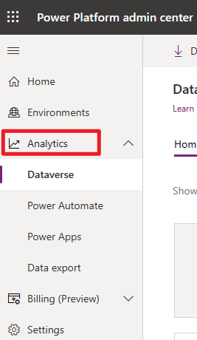
Gain Deeper Insight on Adoption, & Usage
https://aka.ms/ppac
Admin analytics
Available from Power Platform admin center
Tenant and environment level analytics
Access for environment admins, power platform service admins, D365 and global admins
Data is stored for 28 days
Data is refreshed daily

Slide 22

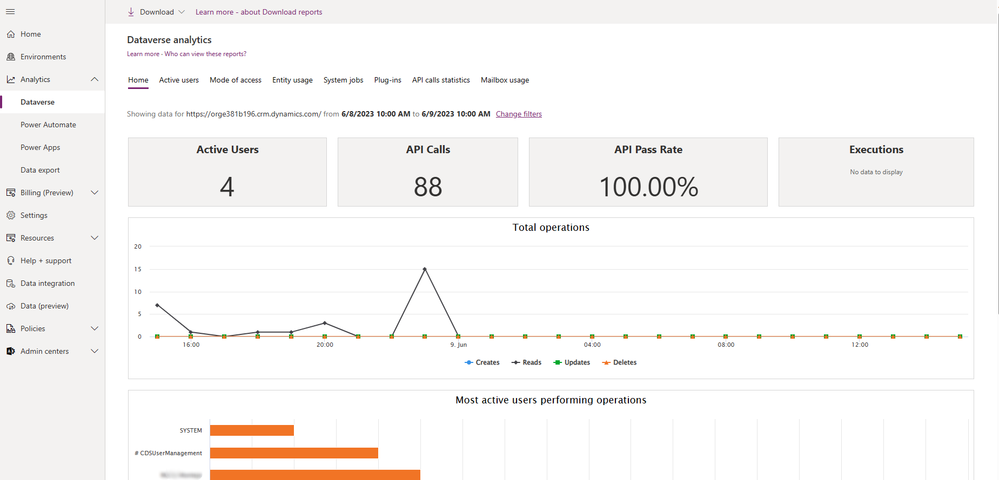
Monitoring Microsoft Dataverse
Click on Change Filters to select from a list of environments you have access to, as well as adjust the date range. The data will only be presented in the prior 28-day period.

Slide 23
Detailed Insight on Microsoft Dataverse
View insights at the environment level
Number of active users, trends, top active users
Mode of access by OS, device type, browser, business unit, security role
Dataverse out of the box and custom entity usage based of Creates, Reads, Updates, Deletes
System Jobs, Plug-in’s, and API call statistics
As an administrator:
Confirm access modes by OS, device types or browser is compliant with standards of your organization
Understand specific CRUD (Create, Read, Update, Delete) activities performed with your apps
Get an overview of overall health by regular checks on platform API calls, system jobs operating, plug-in’s used by app makers

Slide 24
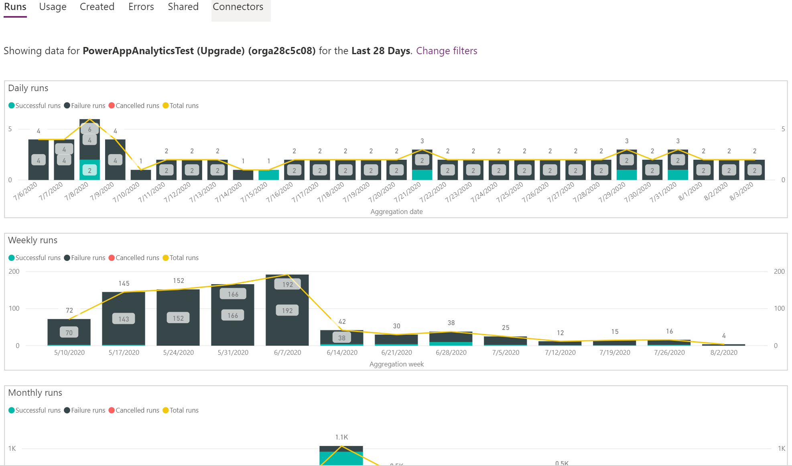
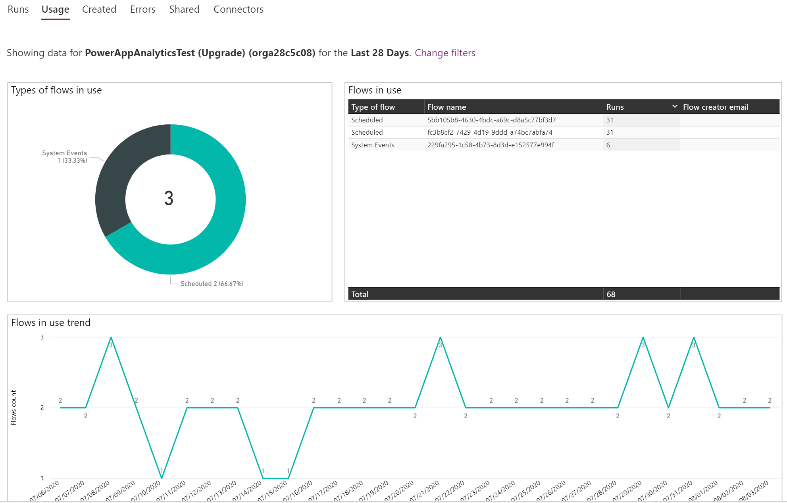
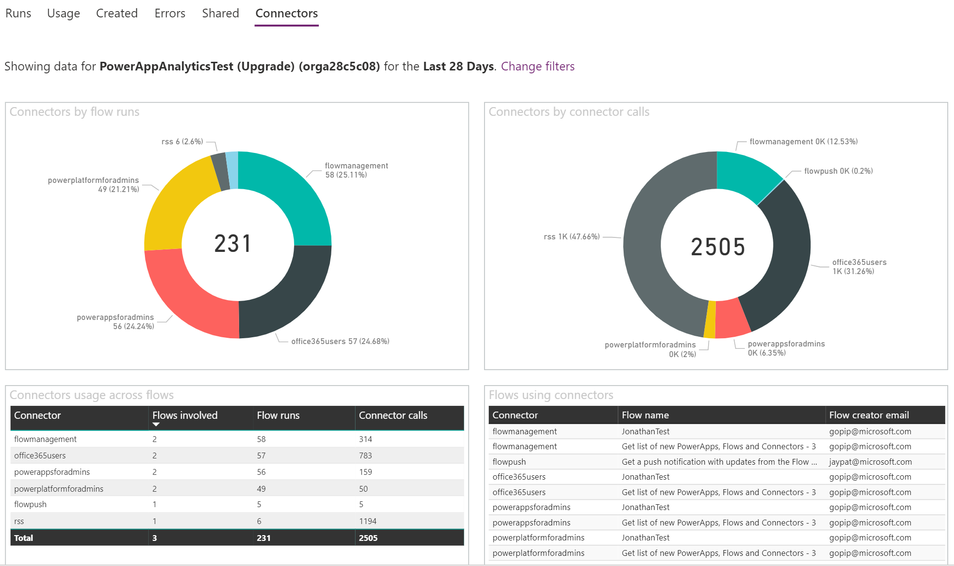
Power Automate Environment Level Views
Analytics is available for a 7, 14, 28-day time periods and allows users to switch between environments.

Slide 25
Detailed Insight on Power Automate
Administrators can view data at the environment level
Type of flows created
Flow creation trends
Created flow list of view
Run metrics – Active runs, success and failure
Flow in use and trend
Shared flows and types, flow names, number of shares
Connectors by runs, number of connections, flows involved and drill down on flows
Total number of errors based off error types
Errors across flows with list of errors by flow name
As an administrator:
Monitor usage and look for insights related to types of flows that ae in use
Identify common errors by looking for errors by error type
Get insights into connector usage per flow along with flow creator email. Adjust data loss prevention policies to ensure no unnecessary flows are created in the environments and ensure overall security of platform
Note – Desktop Flow analytics is available in the COE toolkit

Slide 26
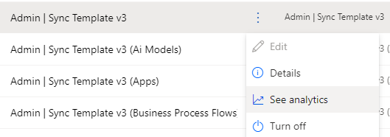
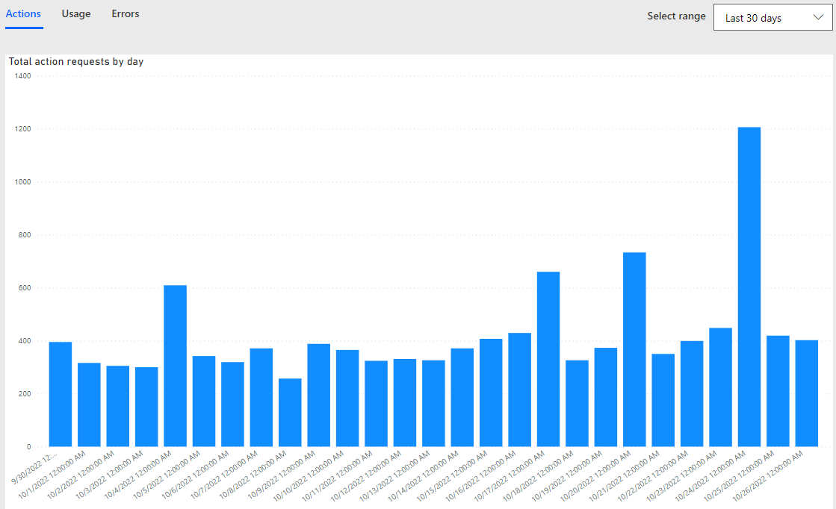
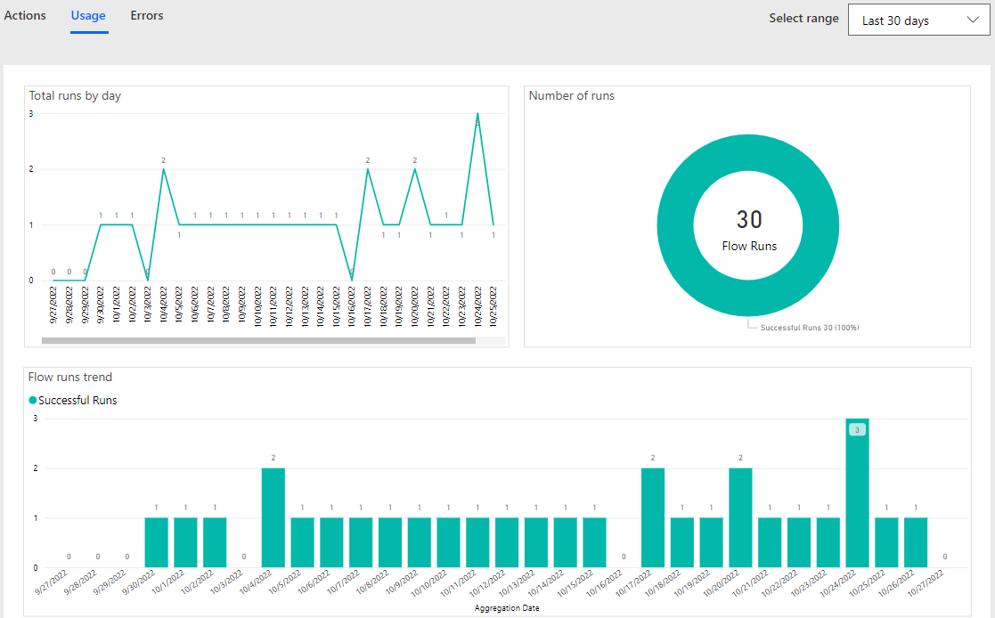
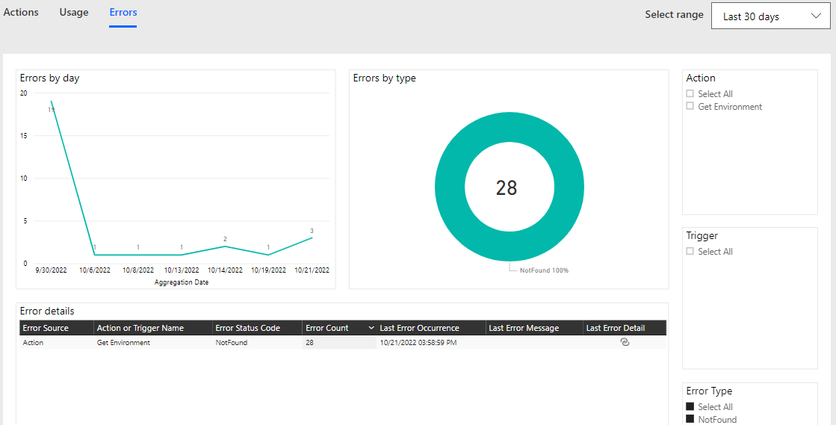

Maker analytics for Power Automate
Individual flow level views which can be used by flow owners to view details for each flow within their scope, for last 7, 14, 28 days with data refreshed every 4-6 hours
Flow Usage
Flow Health
API usage
Runs by day
Total number of runs for the flow
Gain insights into when the flow is run with the flow run trends
The number of errors per day
Flow errors by type
Understand the details of a specific error – Error source, action or trigger name, error status code, error count, last error occurrence, last error message and detail

Slide 27
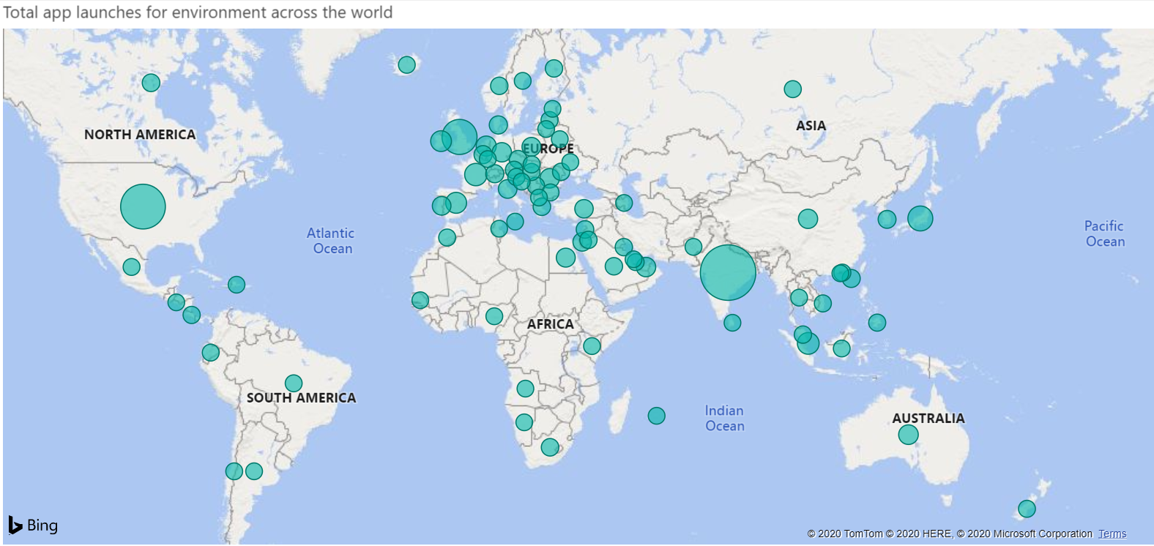
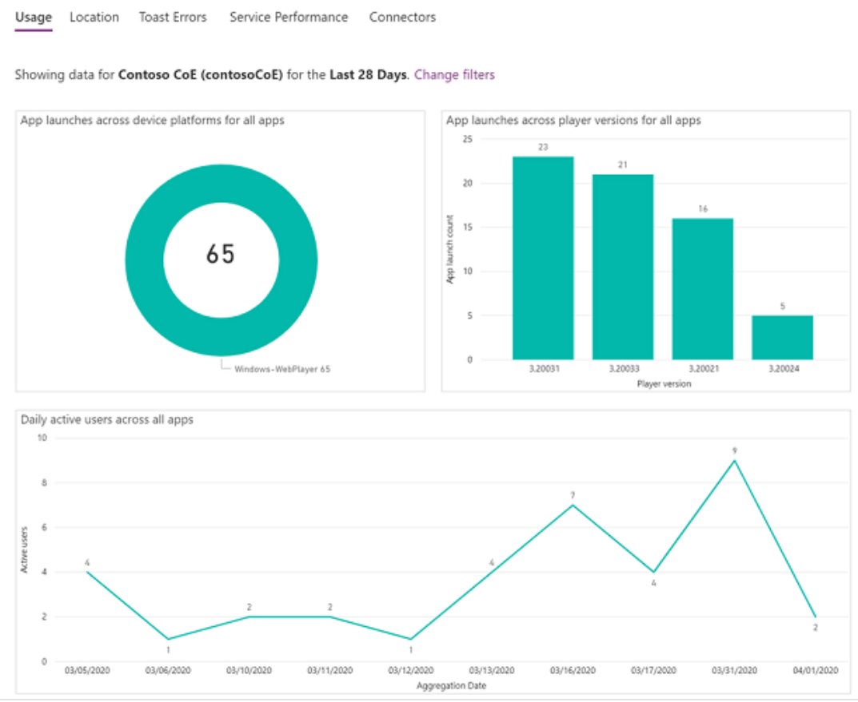
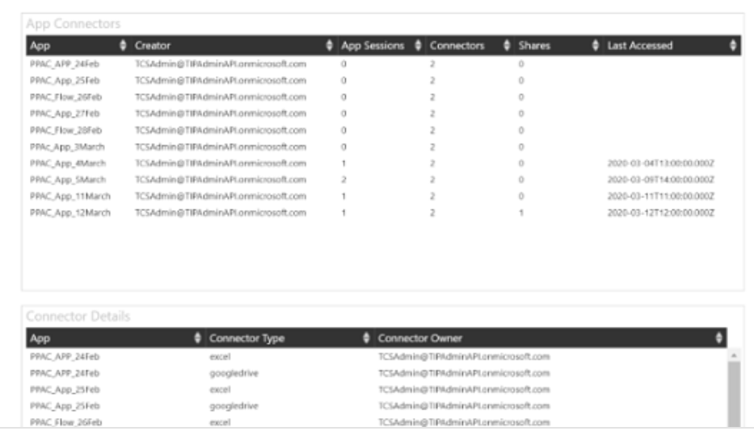
Power Apps Environment level views
Analytics is available for a 7, 14, 28-day time periods and allows users to switch between environments.

Slide 28
Detailed Insight on Power Apps
Administrators can view data at the environment level for canvas apps
Active Users – How many users are using the app and daily active usage
Location – Where is the app usage and filter by country
App Usage – App launches with filters for device platform, player version, country
Toast errors are errors which end users see
Errors per app in the environment,
Error trends across apps,
Overview across all apps for error breakdown by https status
Service Performance – Best and lest performing service(std and custom) in the environment
As an administrator:
Monitor how much and where apps are being used
Check out the platform being used to launch the apps, browser or mobile, Tailor your app updates based on platform and ensure that users are on the latest player version to ensure latest platform updates
Identify apps with most errors and common http errors and work with makers to understand and fix issues ensure overall security of platform
Get an overview of overall performance of different custom and standard API”s being used in the apps. Work with teams to fix issues proactively

Slide 29
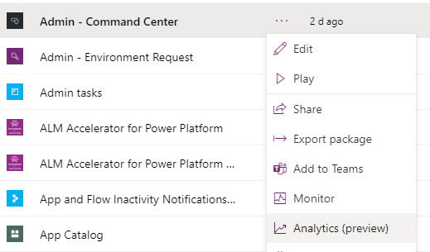
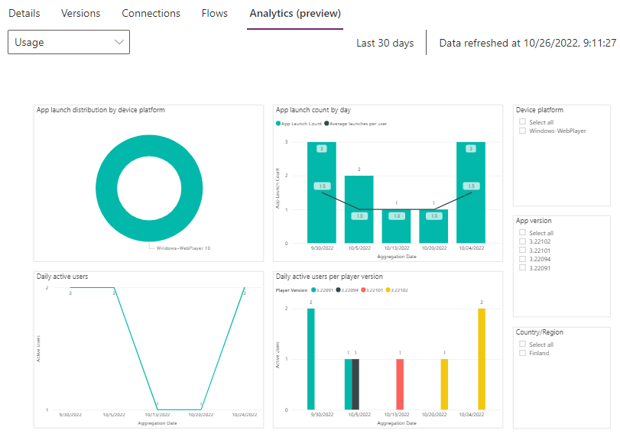
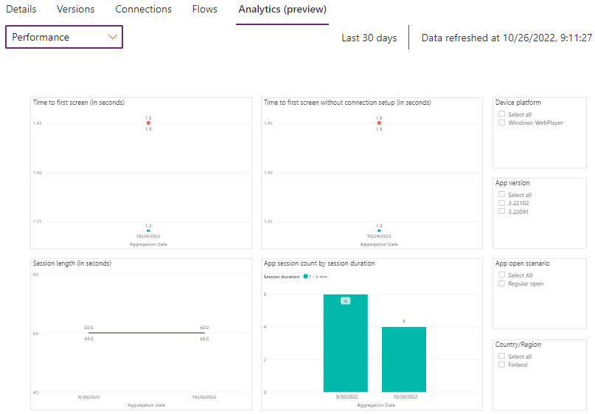
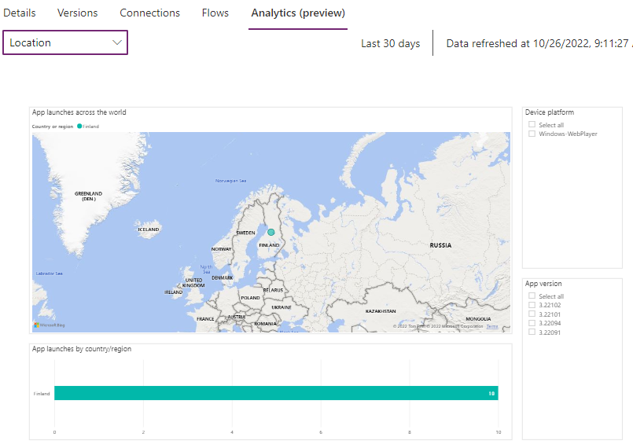
Maker analytics for Power Apps
Individual Power App level views which can be used by App Makers and Administrators to view details for each app within their scope, for last 7, 14, 28 days with data refreshed every 4-6 hours
App Adoption and Usage
App Health
Active Users – How many users are using the app and daily active usage
Location – Where is the app usage and filter by country
App Usage – App launches with filters for device platform, player version, country
Toast errors are errors which end users see
Errors per app in the environment,
Error trends across apps,
Overview across all apps for error breakdown by https status
Performance – Best and lest performing service(std and custom) in the environment

Slide 30
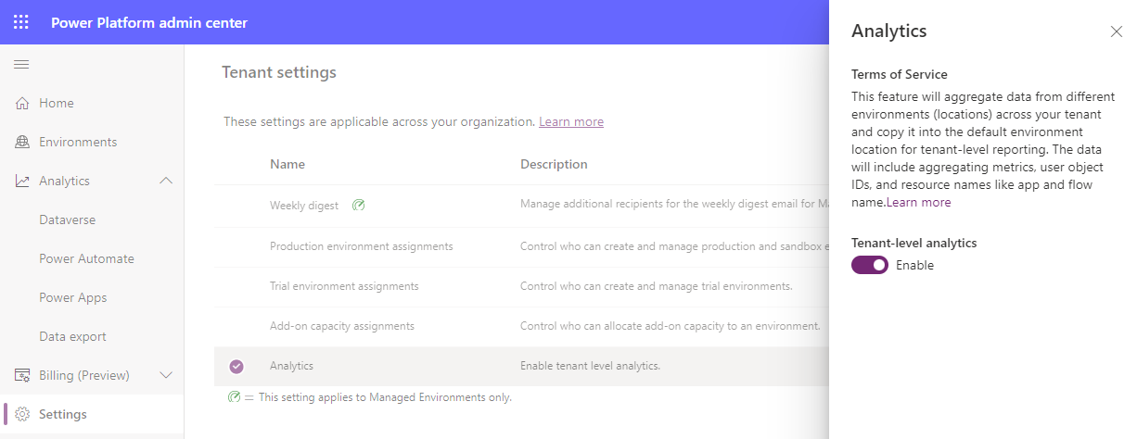
Tenant Level Analytics
Available for canvas & model-driven apps, flows and environments
Need to be explicitly enabled in Power Platform settings
Usage and activity reports shows 28 days

Slide 31
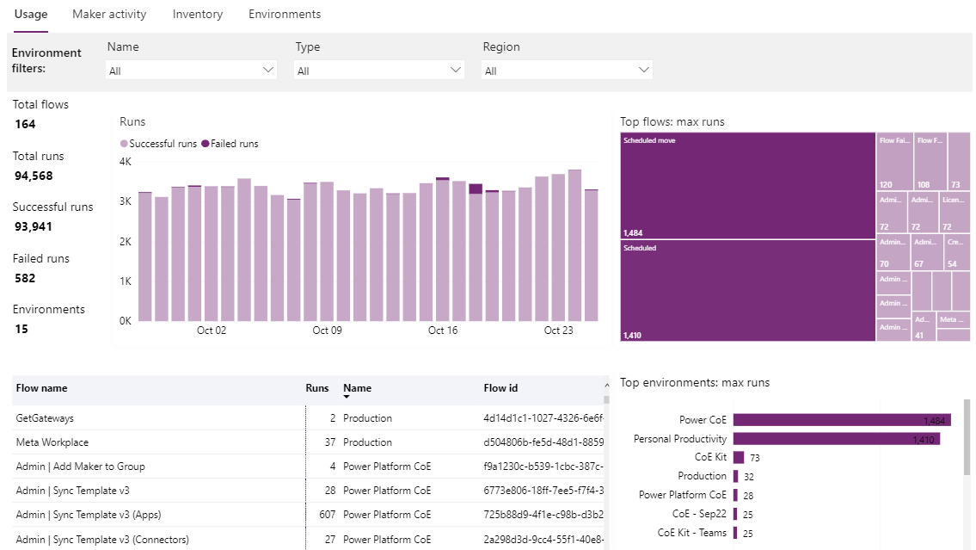
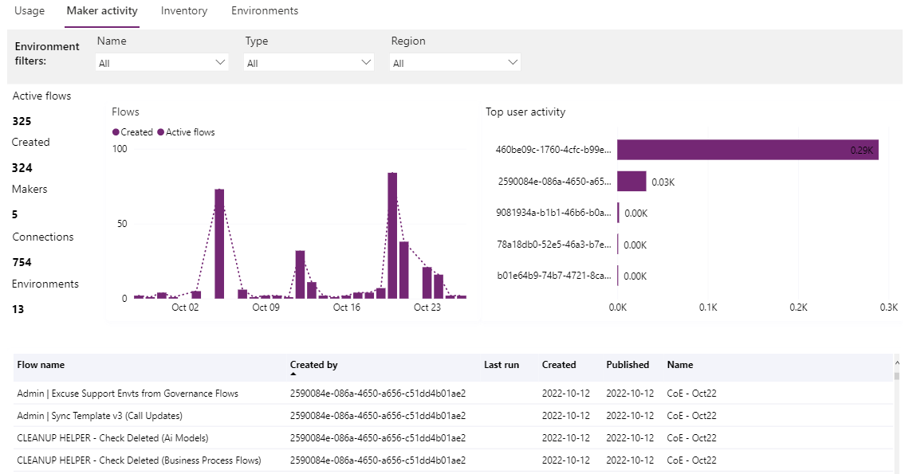
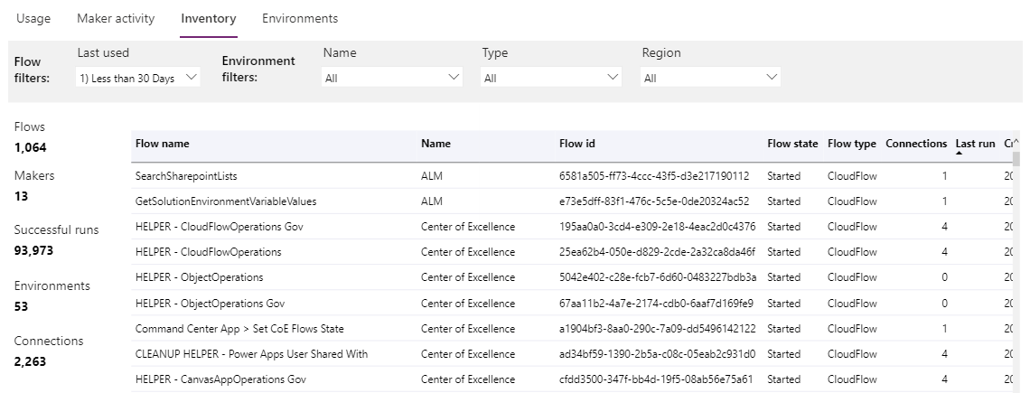
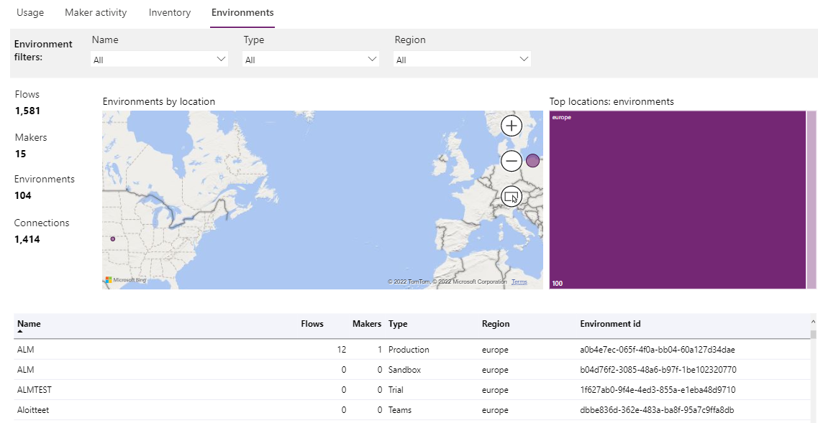
Power Apps Tenant Level Analytics
Unique users, Total sessions, Apps used, New users, Environments
Usage activity
Top Apps – Sessions / Unique users
Top Environments – Unique users
Maker activity
App inventory
As an administrator:
Monitor top apps and environments per activity
Monitor maker activity
See total number of Apps, Makers, Environments, Connections
See information when App is created, modified, last launched and for how many users/groups app is shared
Reports can be filtered by environment, environment type/state/region, app type, and app last used

Slide 32
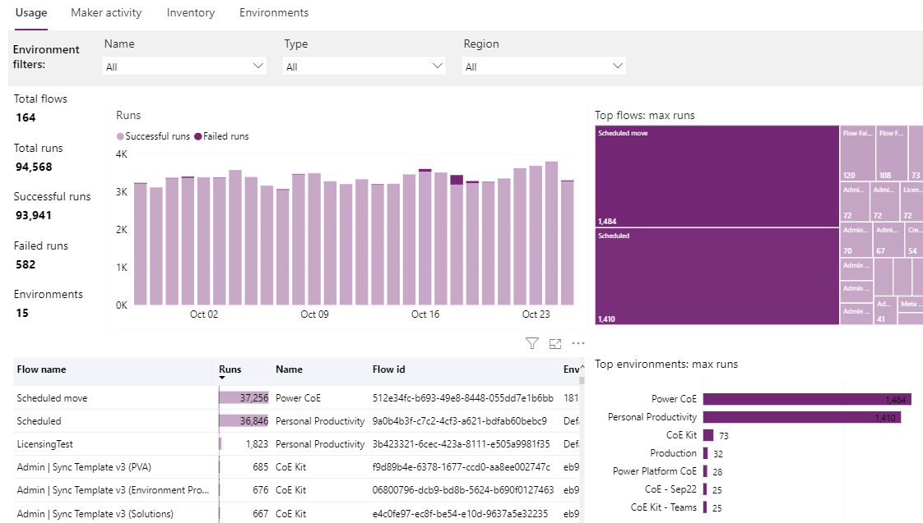
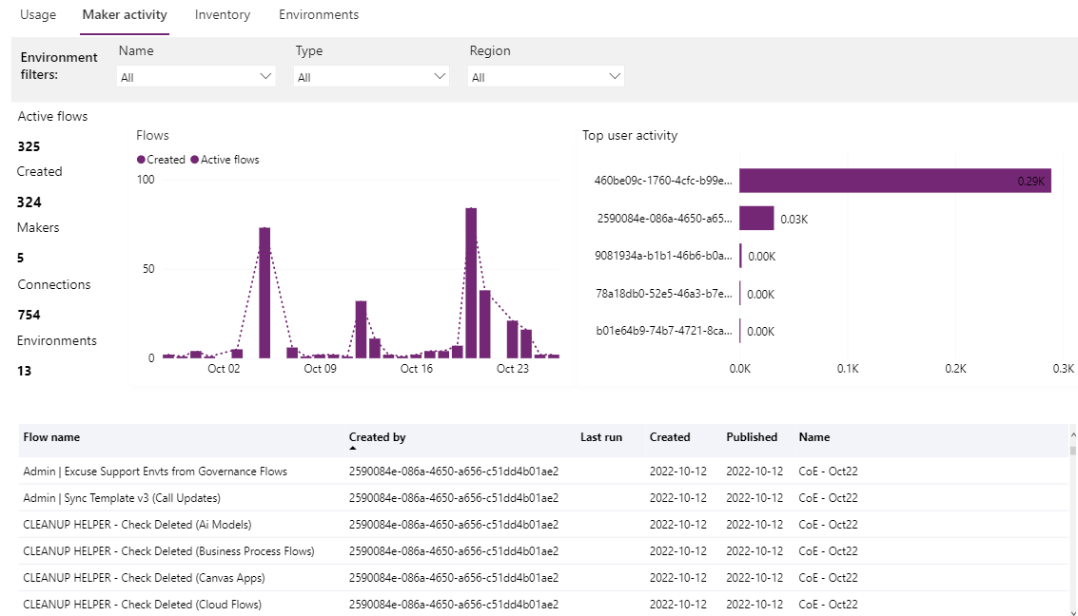
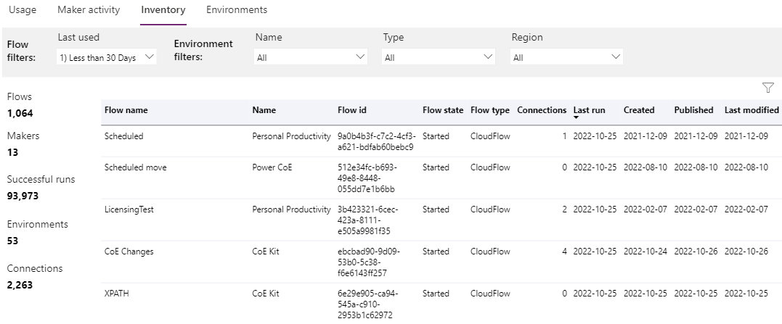
Power Automate Tenant Level Analytics
Flow runs
Usage activity
Top Flows – Max runs
Top Environments – Max runs
Maker activity
Inventory
As an administrator:
Monitor top flows and environments per activity
Monitor maker activity
See total number of Flows
See information when Flow is created, modified, last executed
Reports can be filtered by last run, environment and environment type or region

Slide 33
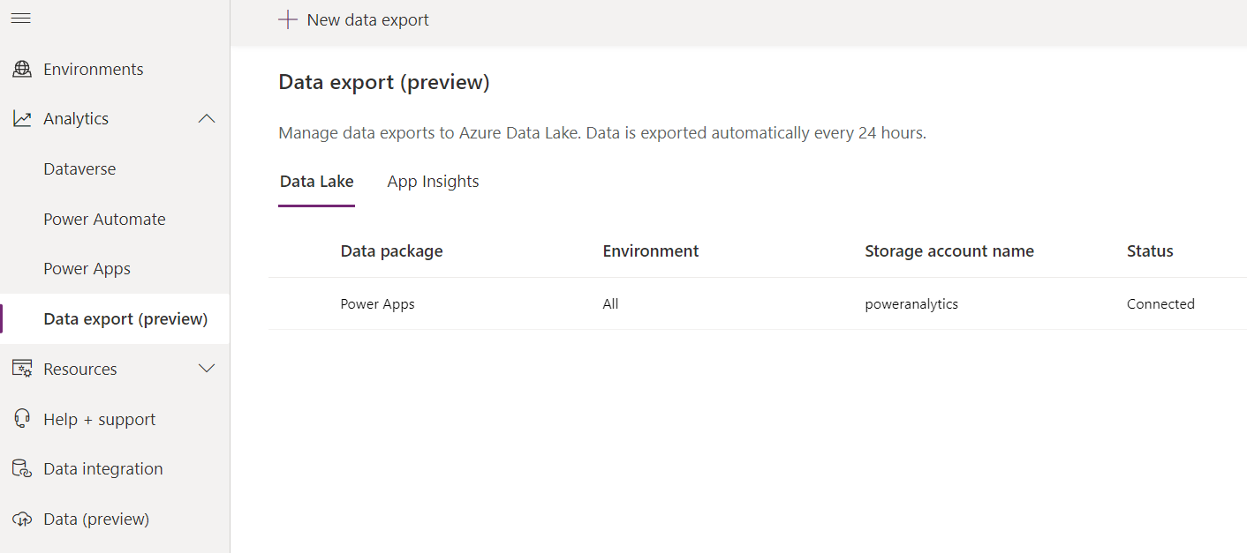
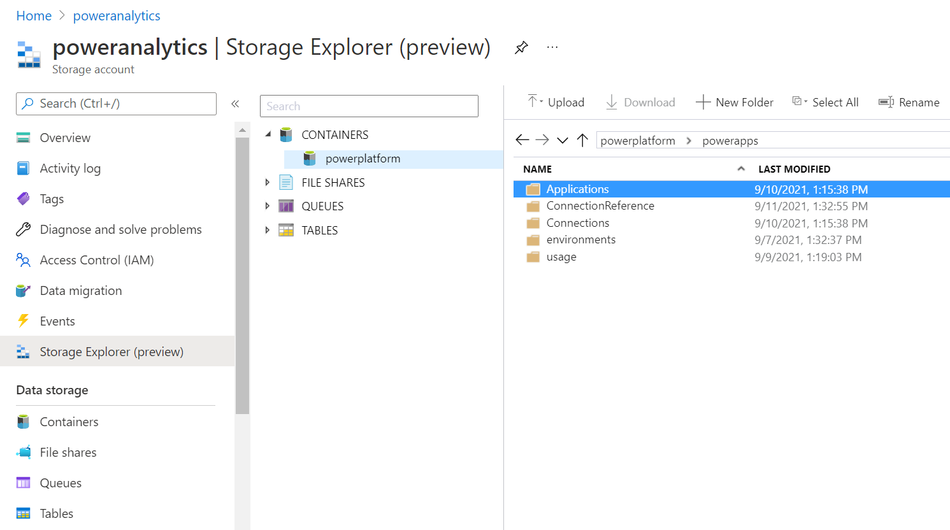
Data Export (Preview)
Tenant level analytics
Export tenant level analytics to Azure Data Lake
Bring Your Own Data Lake (BYODL)

Slide 34
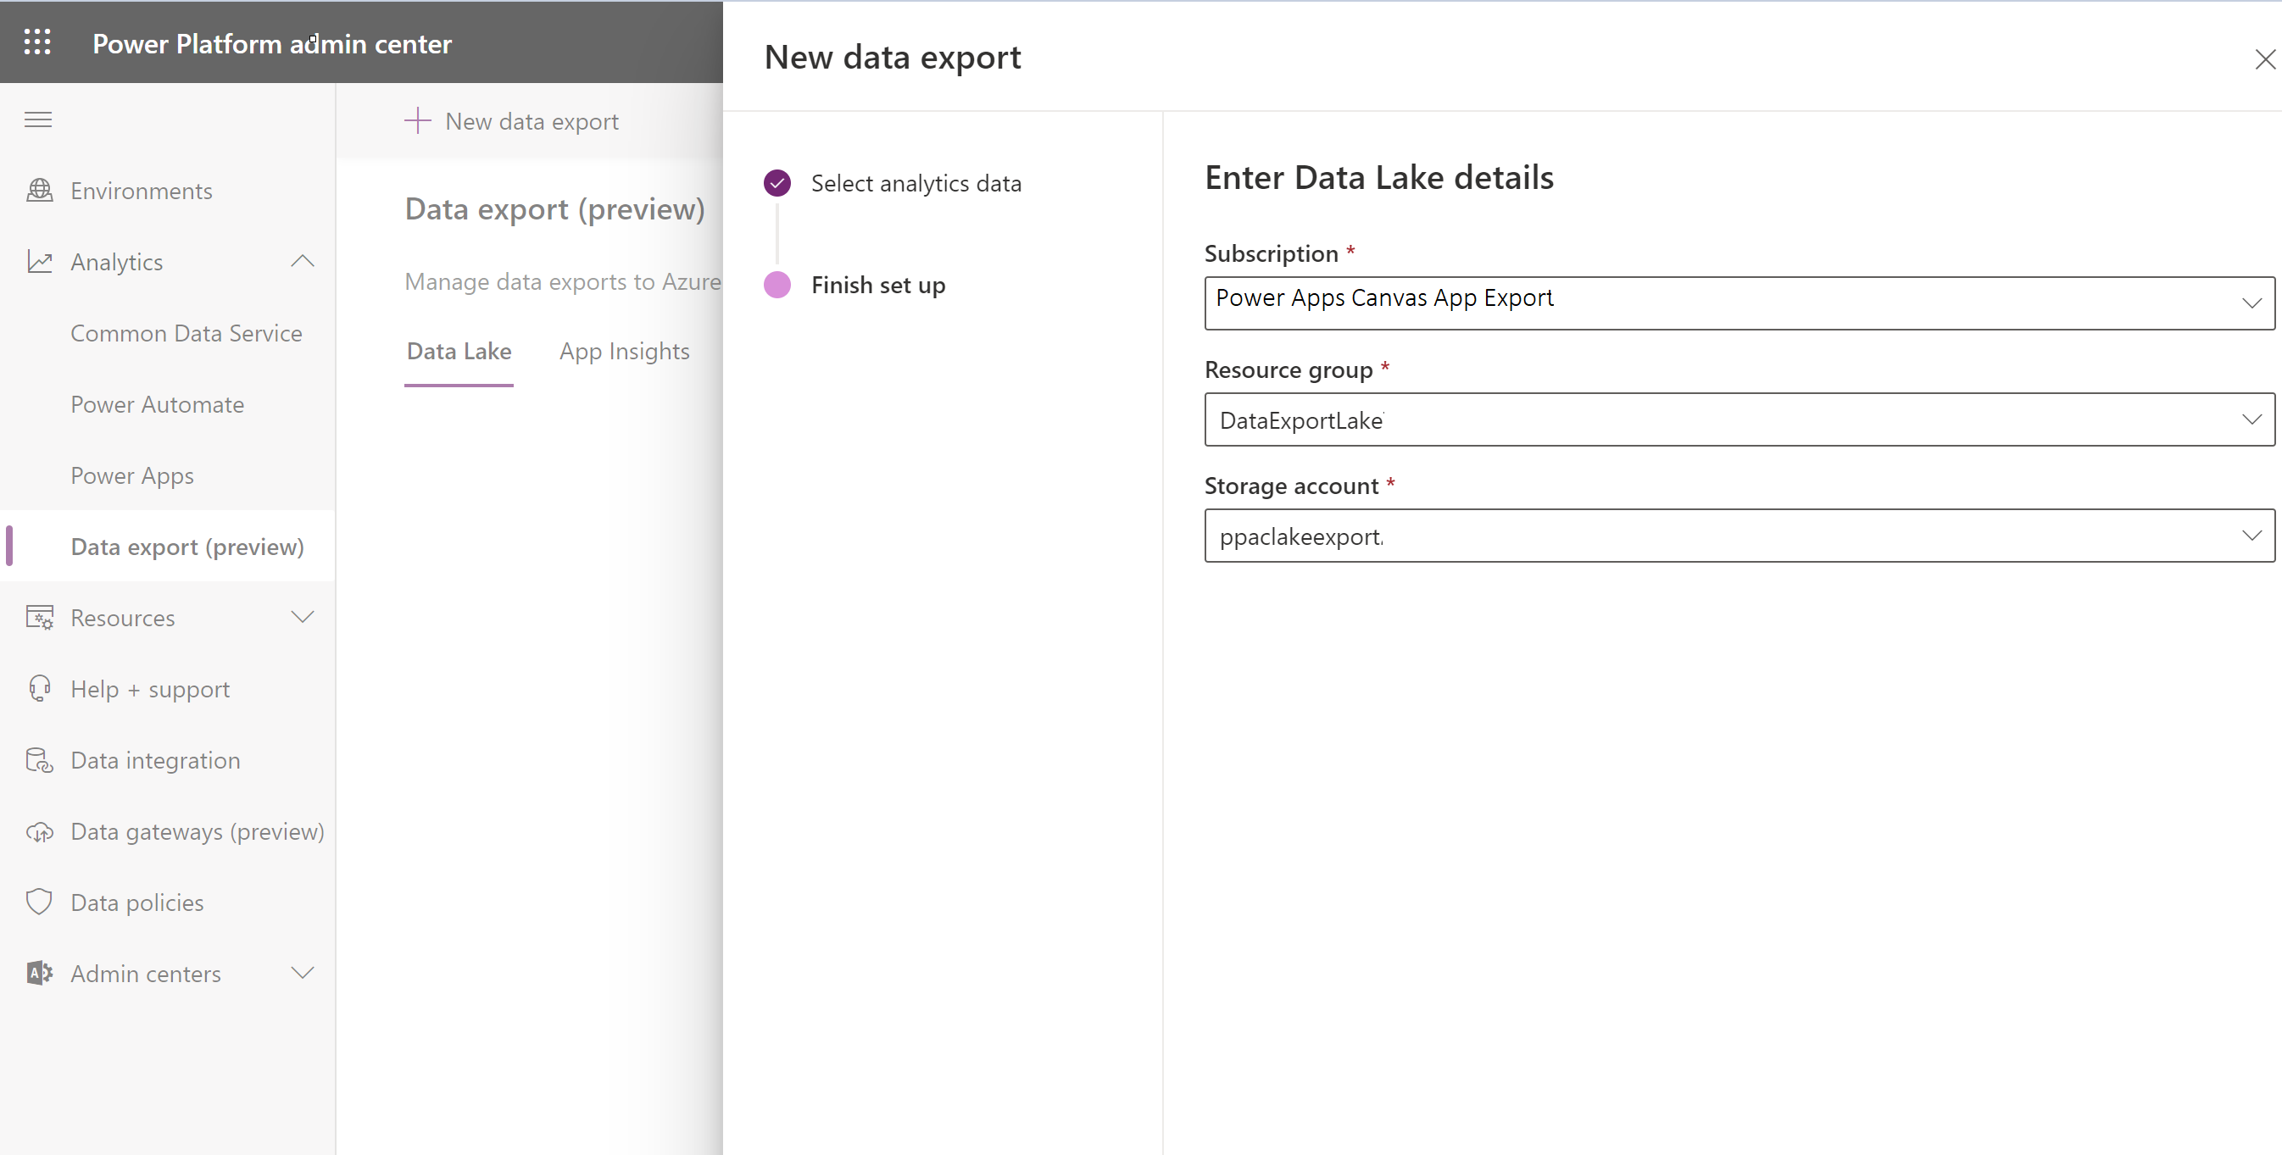
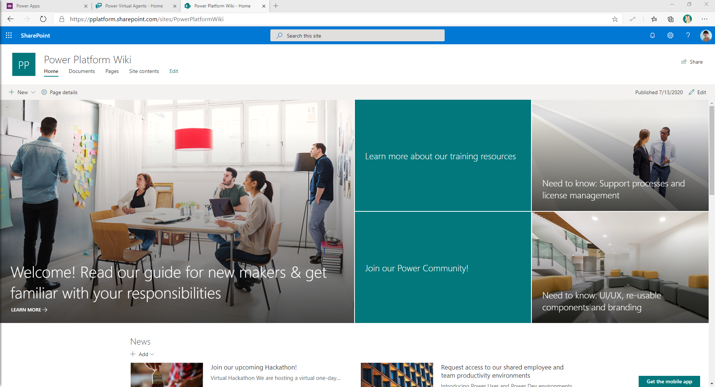
Data Export (Preview)
Tenant level analytics
1
Set up Data Lake Export

Slide 35
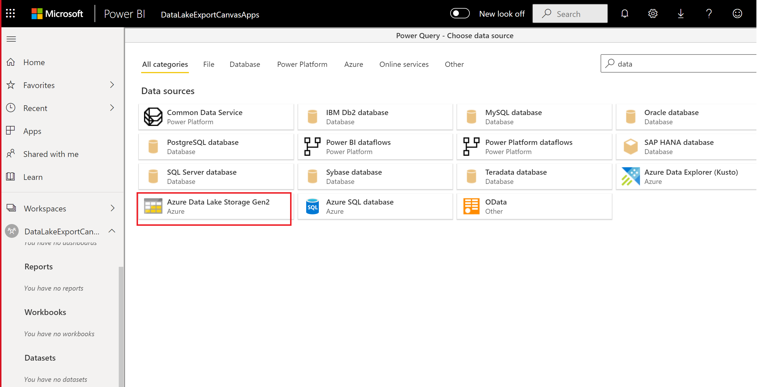
Data Export (Preview)
Tenant level analytics
1
Set up Data Lake Export
2
Use Power BI data flows to connect to the data lake

Slide 36
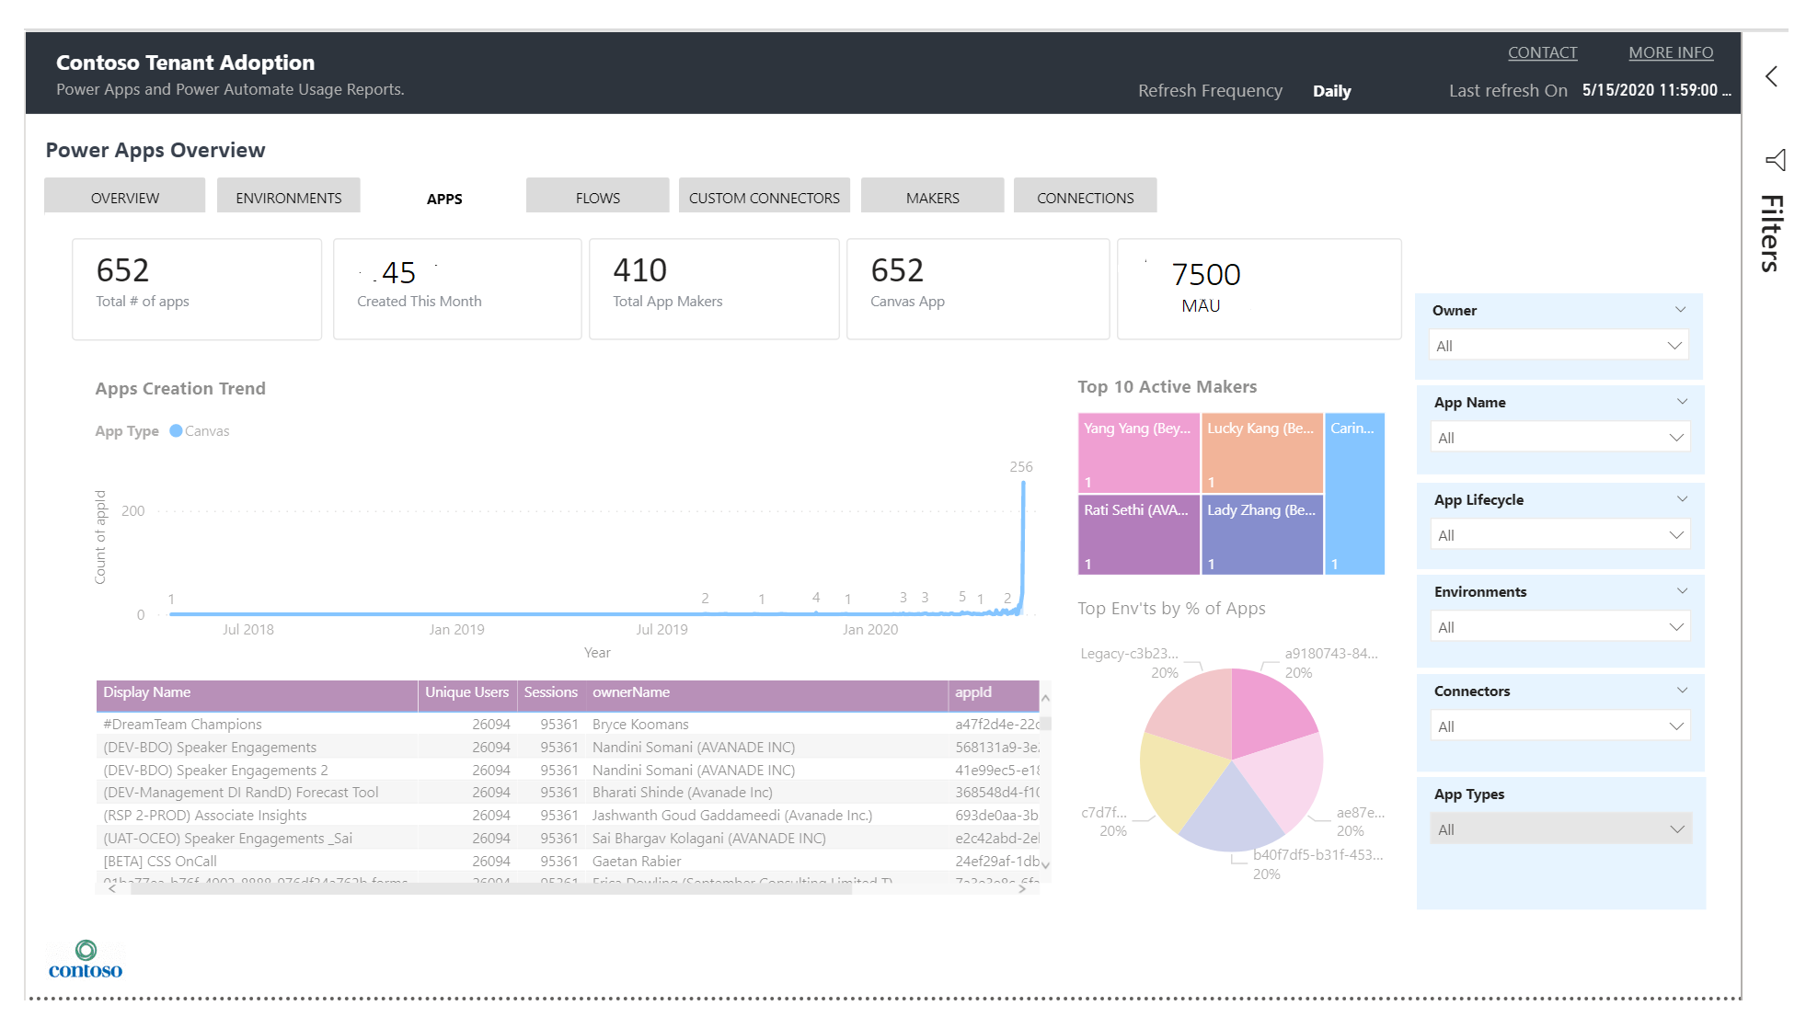
Data Export (Preview)
Tenant level analytics
1
Set up Data Lake Export
2
Use Power BI data flows to connect to the data lake
3
Build and share custom reports

Slide 37
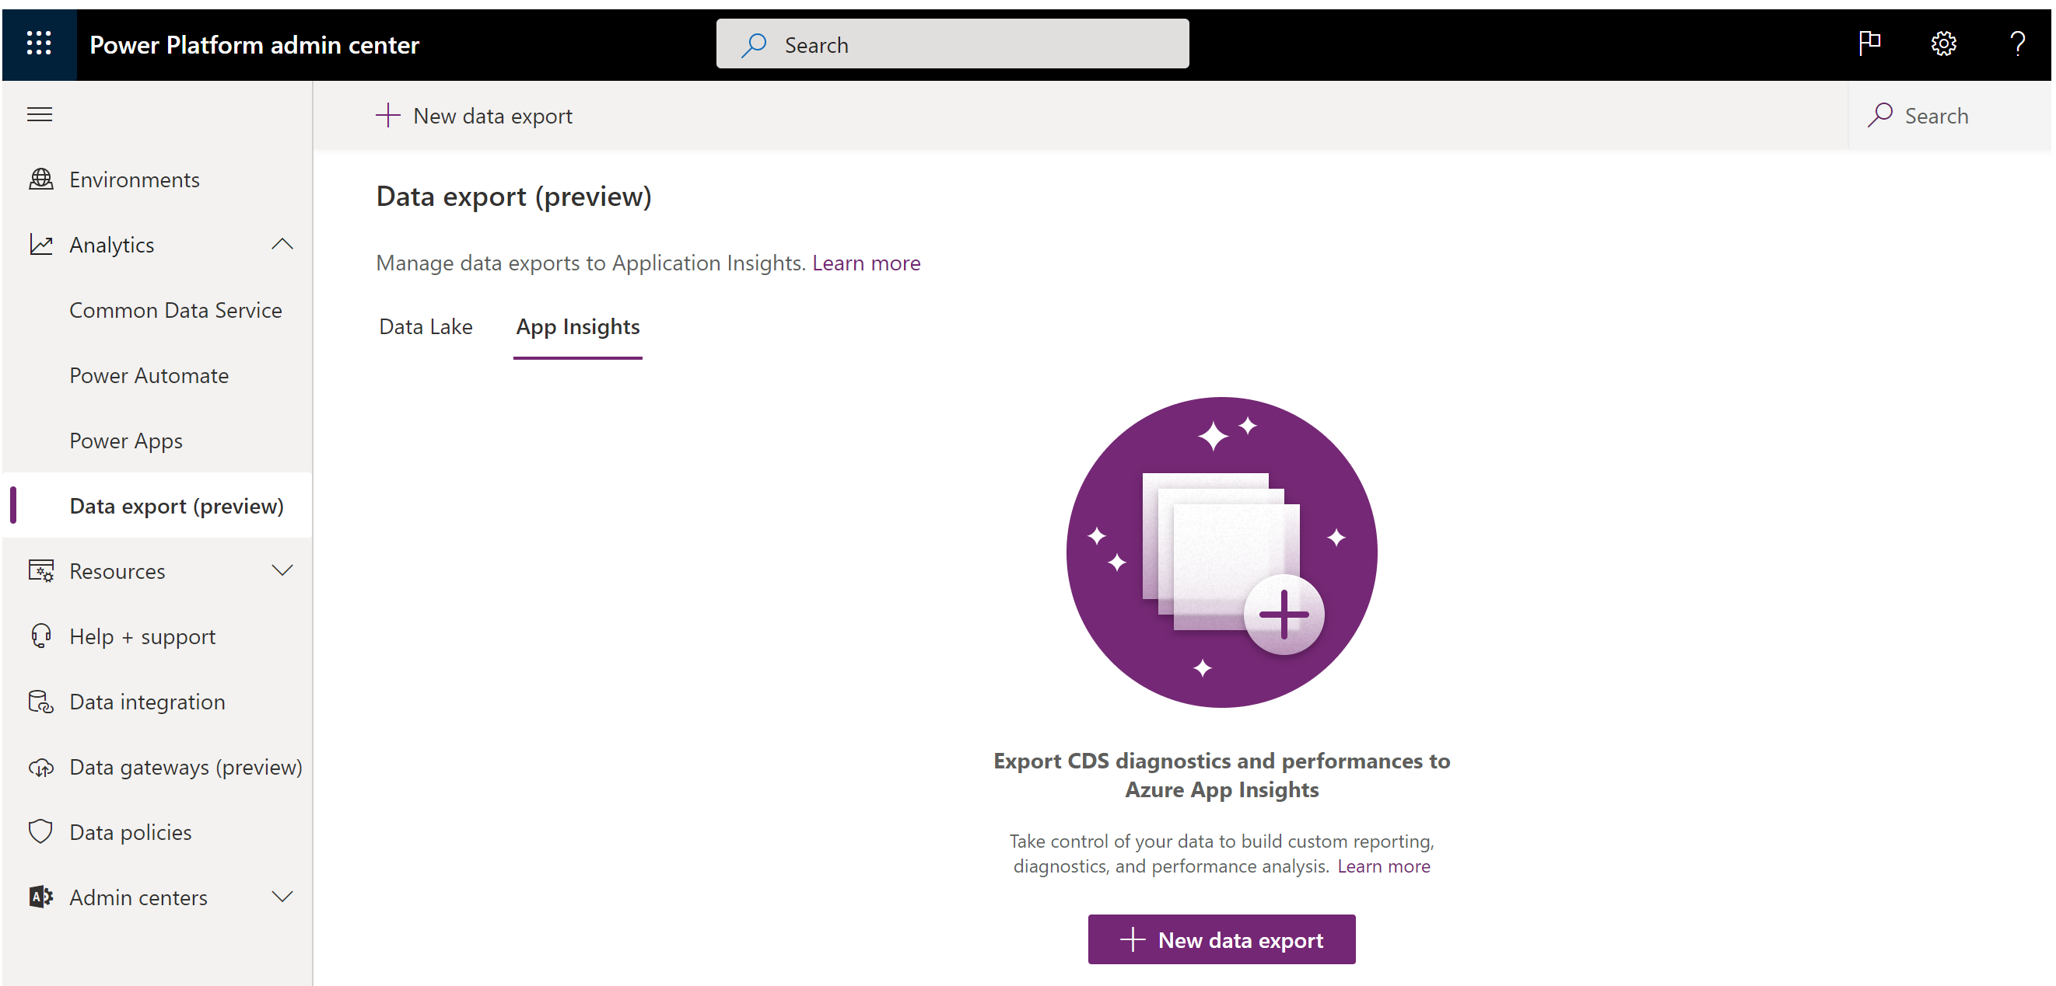
Analyze model-driven apps, Microsoft Dataverse and Cloud Flows telemetry with Application Insights

Slide 38
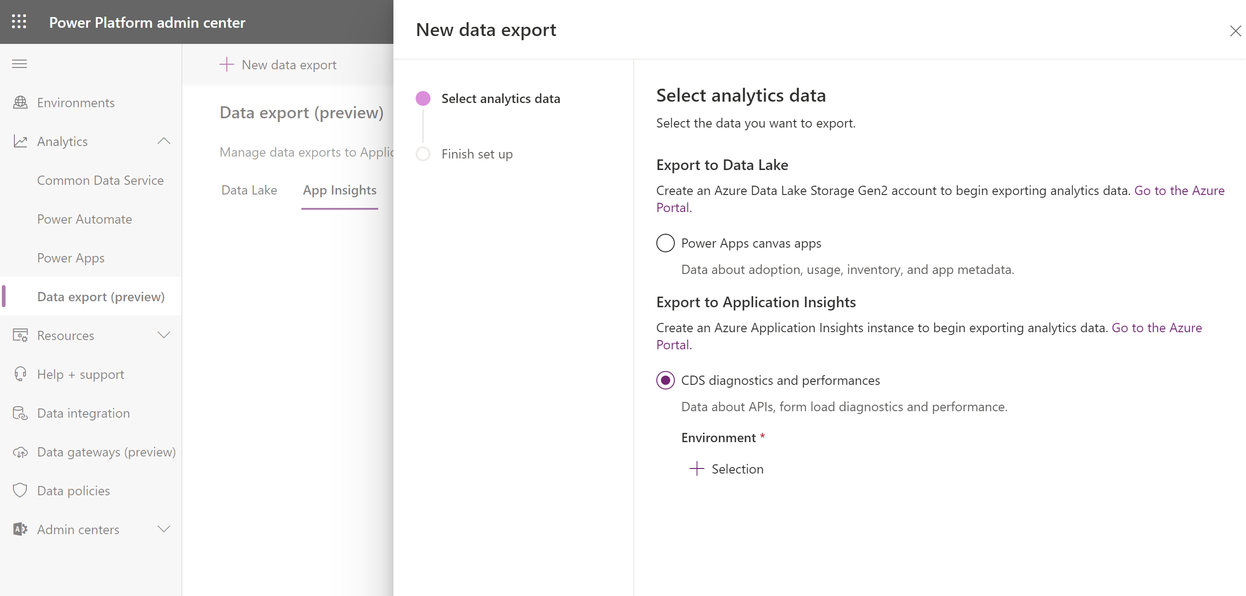
Analyze model-driven apps, Microsoft Dataverse and Cloud Flows telemetry with Application Insights
1
Set up continuous export

Slide 39
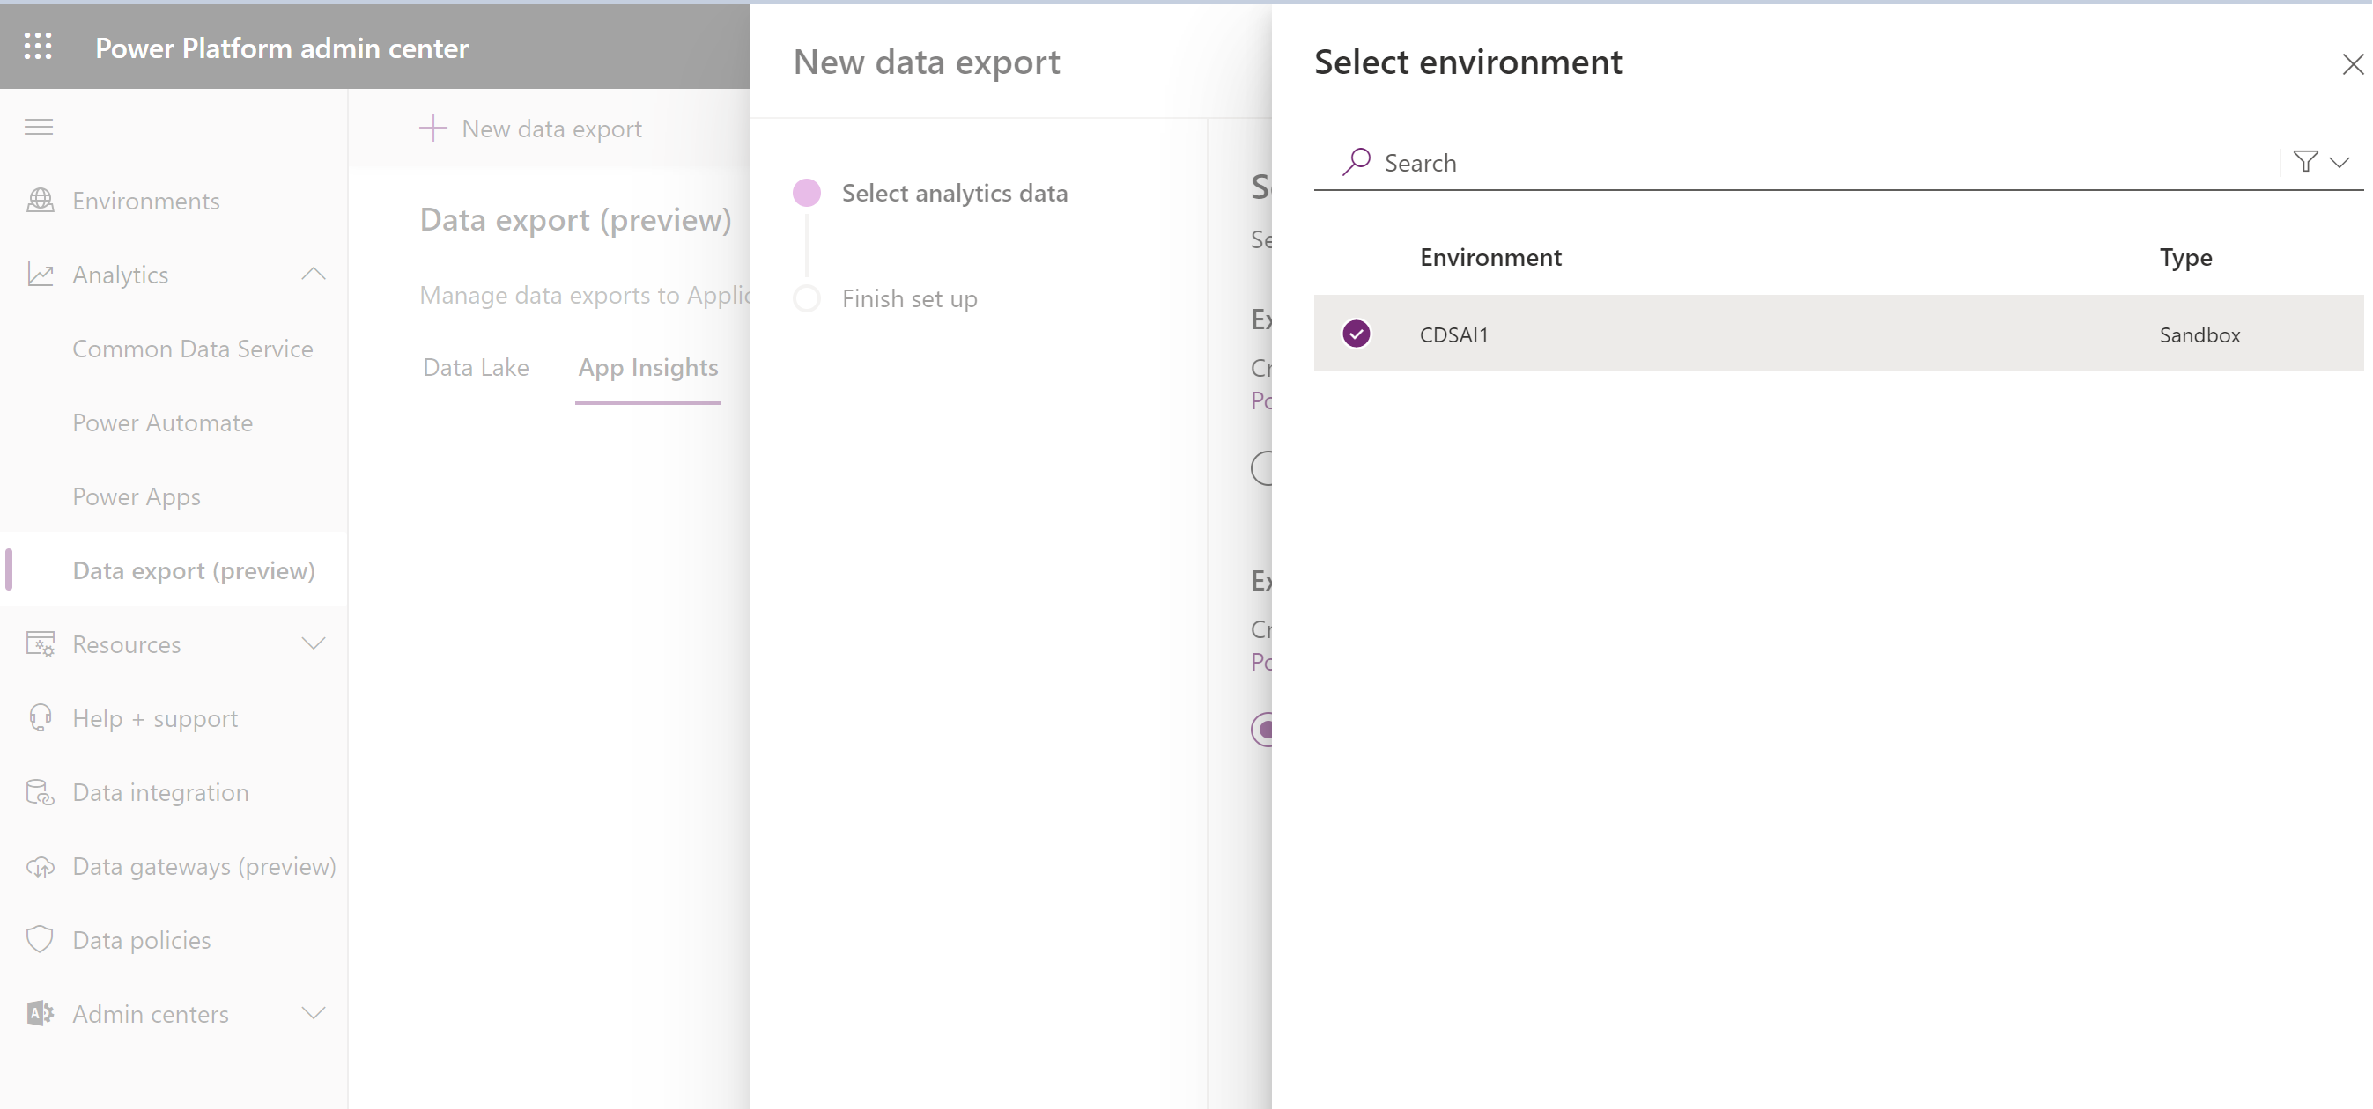
Analyze model-driven apps, Microsoft Dataverse and Cloud Flows telemetry with Application Insights
1
Set up continuous export
2
Select environment

Slide 40
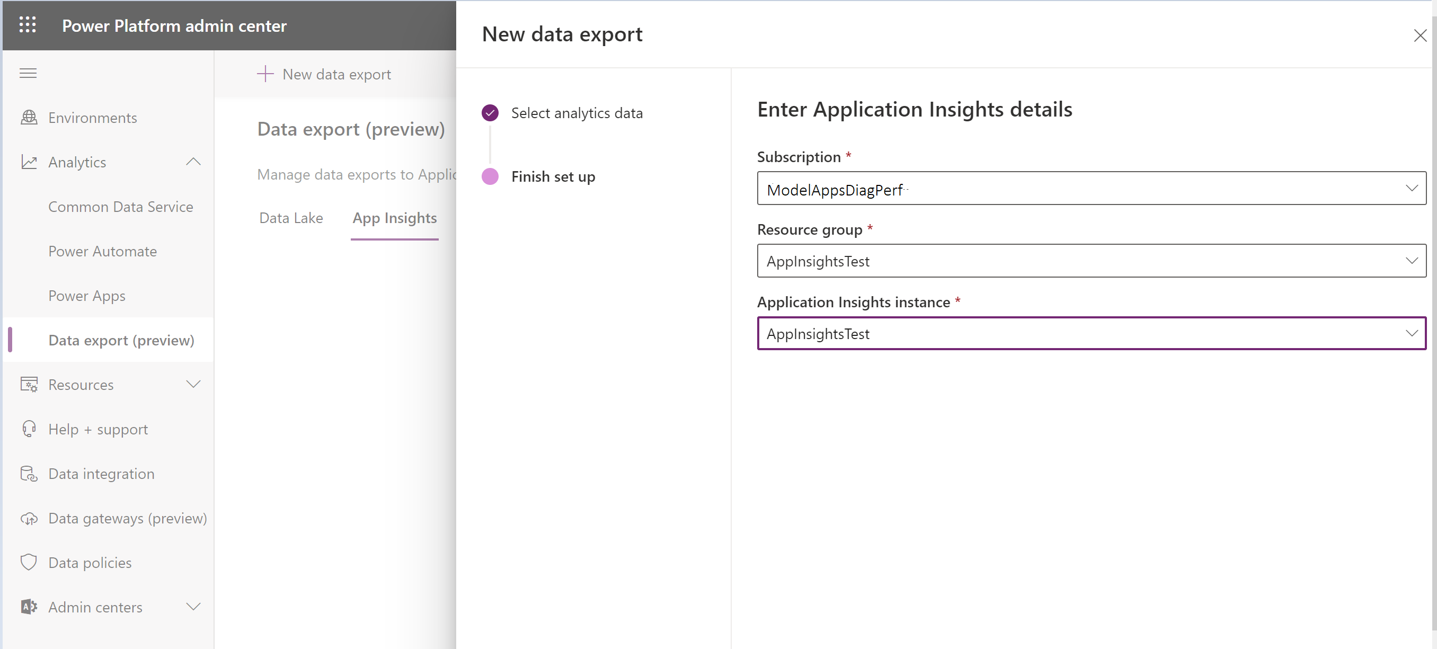
Analyze model-driven apps, Microsoft Dataverse and Cloud Flows telemetry with Application Insights
1
Set up continuous export
2
Select environment
3
Provide Application Insights instance

Slide 41
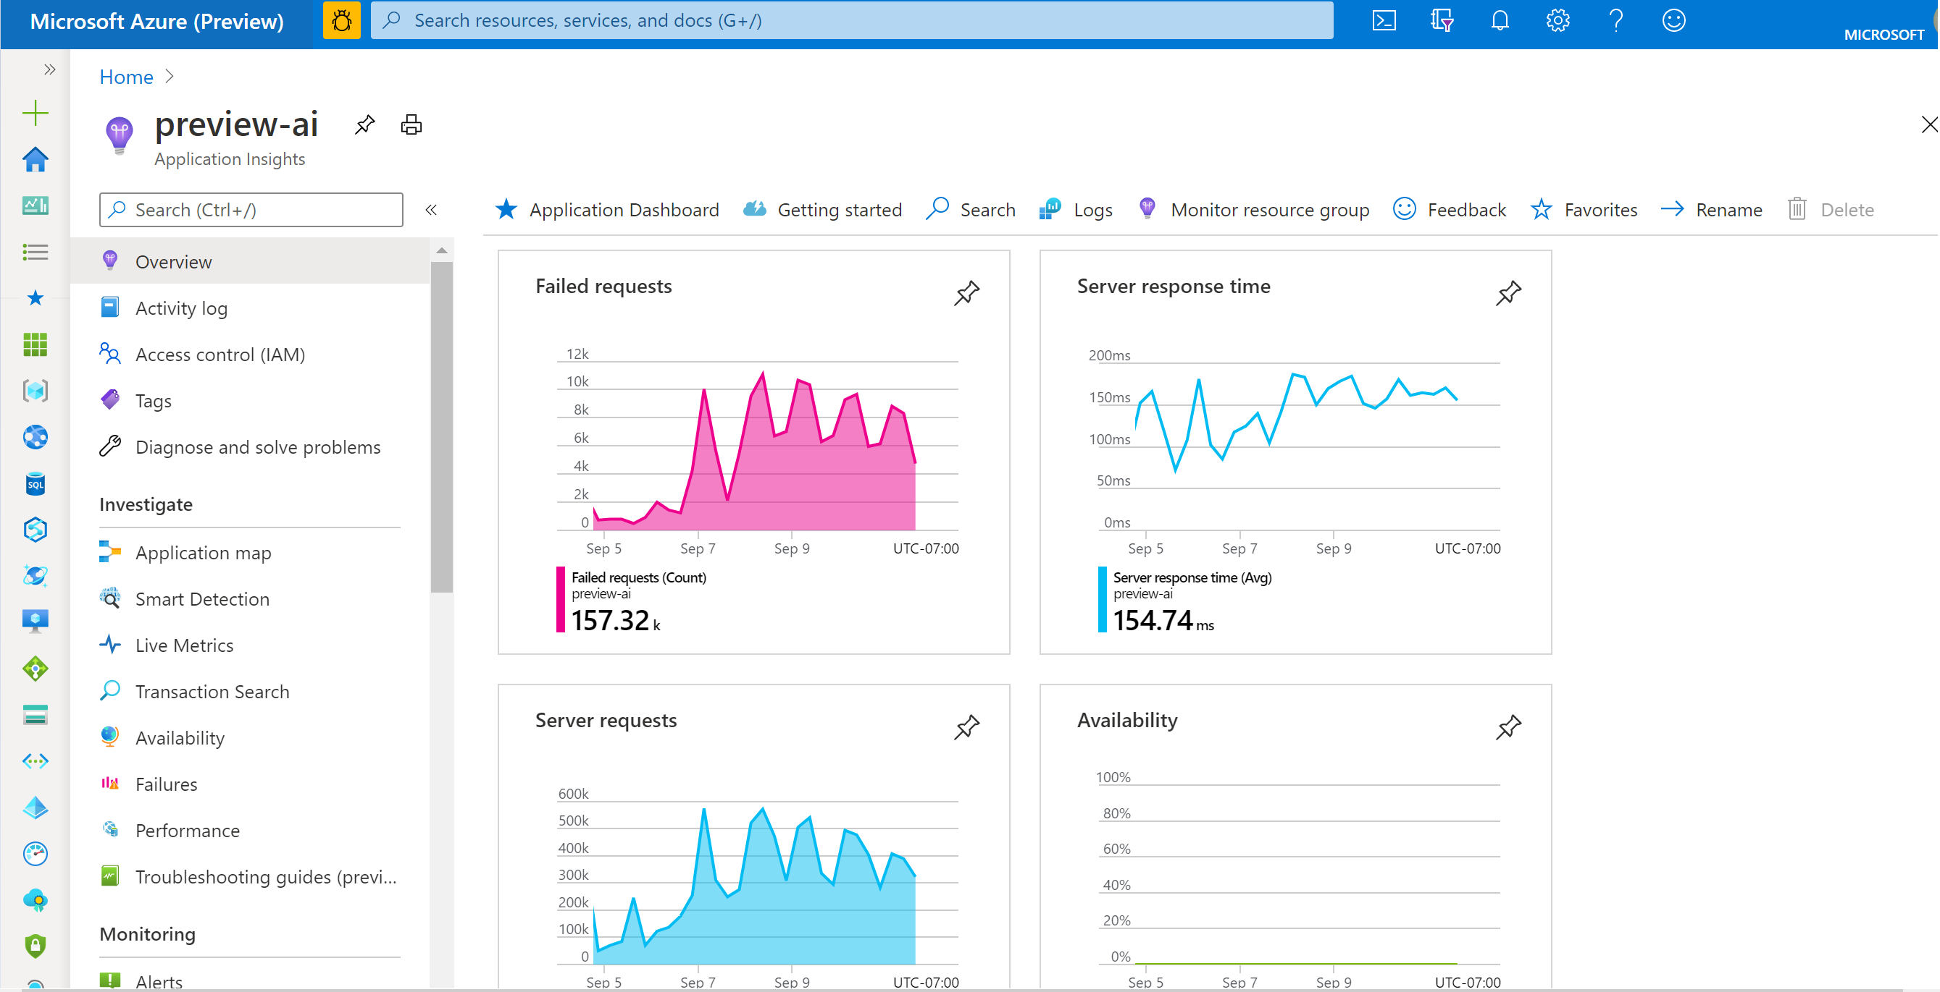
Analyze model-driven apps, Microsoft Dataverse and Cloud Flows telemetry with Application Insights
1
Set up continuous export
2
Select environment
3
Provide Application Insights instance
4
OOB reports with App Insights

Slide 42

Analyze model-driven apps, Microsoft Dataverse and Cloud Flows telemetry with Application Insights
1
Set up continuous export
2
Select environment
3
Provide Application Insights instance
4
OOB reports with App Insights
5
Custom query with Log Analytics

Slide 43
Demonstration
Dataverse, Power Apps and Power Automate analytics
Demo the following:
Go through analytics reports in PPAC
Notes:
Consider demoing the following:
Go through analytics reports in PPAC
##########

Slide 44
Health Monitoring of Power Platform Services

Slide 45



Monitoring platform status
Power Apps and Automate service status can been seen in both portals and Office 365 Service Health https://admin.microsoft.com/Adminportal/Home?source=applauncher#/servicehealth
https://powerapps.microsoft.com/en-us/support
https://make.powerautomate.com/support/

Slide 46

Monitoring platform updates and changes
Power Apps and Automate services platform updates and changes can be monitored in Office 365 Message Center
https://powerapps.microsoft.com/en-us/support
https://flow.microsoft.com/en-us/support

Slide 47
Demonstration
Power Apps and Automate service health
Demo the following:
Show how to check Power Apps and Automate service health status in
https://powerapps.microsoft.com/en-us/support
https://flow.microsoft.com/en-us/support
https://admin.microsoft.com/Adminportal/Home?source=applauncher#/servicehealth
Notes:
Consider demoing the following:
Show how to check Power Apps and Automate service health status in
https://powerapps.microsoft.com/en-us/support
https://flow.microsoft.com/en-us/support
https://admin.microsoft.com/Adminportal/Home?source=applauncher#/servicehealth
##########

Slide 48
Questions?

Slide 49
Microsoft

